Slide 1
Anomaly detection for an Industrial process system
By: Hassan El morra

Slide 2
Objectives
Compare different data driven Process Monitoring-Fault Detection (PM-FD) models’ performance using training/test datasets generated from the simulated TEP* and applying different comparisons to identify the best performing model
Apply Cross-project prediction technique to evaluate the possibility to use models build with easily detected faults to predict new types of faults
*TEP: Tennessee Eastman Process (simulated process

Slide 3
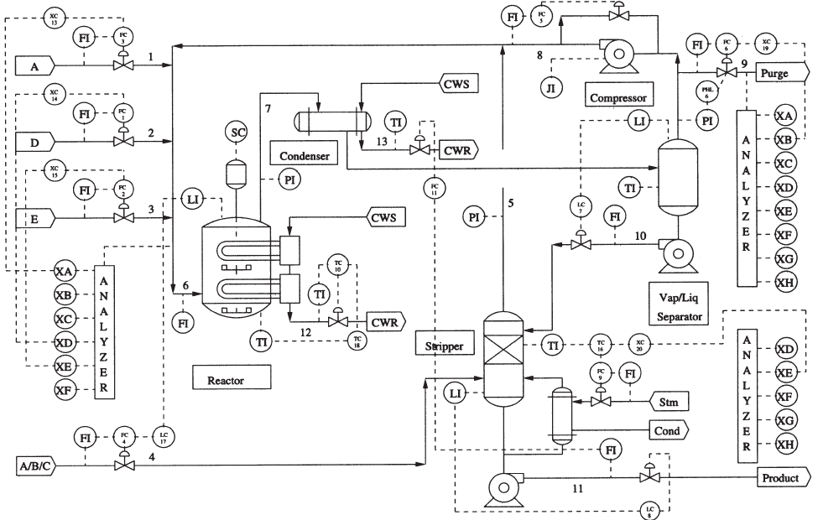
Description of the system/data
 | No Fault run (d00) | Fault Run (d01 - d21)
# samples training | 500 | 480
# samples testing | 960 | 960
Sampling time | 3 min | 3 min
# features(Variables) | 52 | 52
X=[XMEAS(1),…, XMEAS(41),XMV(1),…,XMV(11)]^{T}

Slide 4
Data Preparation
Fault number | Process variable | Type | + Gaussain Noise | comments
IDV(0) | Normal |  |  | Normal operation
IDV(1) | A/C feed ratio, B composition constant | Step | Yes
IDV(2) | B composition, A/C ration constant | Step | Yes
IDV(3) | D feed temperature | Step | Yes | Check with Mutual informtion
IDV(4) | Reactor cooling water inlet temperature | Step | Yes
IDV(5) | Condenser cooling water inlet temperature | Step | Yes | Check using mutual information
IDV(6) | A feed loss | Step | Yes
IDV(7) | C header pressure loss-reduced availability | Step | Yes
The data collected for normal operation plus the 7 first anomalies (of type Step) are used to construct the training/testing sets to build the prediction model

Slide 5
Data Preparation
Fault number | Process variable | Type | + Gaussain Noise | comments
IDV(8) | A, B, and C feed composition | Random variable | Yes
IDV(9) | D feed temperature | Random variable | Yes | Hard detection. No observable changes in mean, variance or peak time [7]. Will be ignored initially.
IDV(10) | C feed temperature | Random variable | Yes
IDV(11) | Reactor cooling water inlet temperature | Random variable | Yes
IDV(12) | Condenser cooling water inlet temperature | Random variable | Yes
The data collected for anomalies 8 – 12 is used to test the cross-project validation

Slide 6
Evaluation metrics
Multi-class Confusion Matrix
 | Predict- # of samples in the ith class | Predict- number of samples in the other classes
Actual- # of samples in the ith class | p | b
Actual- # of samples in the other classes | q | d
Fault Detection Rate (FDR) = p / (p+b) (True Positive from confusion Matrix)
False Positive Rate (FPR) = q /(q+d) (False Positive from confusion matrix)

Slide 7
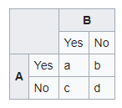





Evaluation metrics
Kappa coefficient
Kappa measures the reliability of a model by measuring the inter-rater agreement for qualitative items. It is an indicator of the agreement between two observers taking into account the possibility of agreement per chance

Slide 8
Evaluation metrics
Kappa | Agreement level
<0 | No agreement
0–0.20 | Slight agreement
0.21–0.40 | Fair agreement
0.41–0.60 | Moderate agreement
0.61–0.80 | Substantial agreement
0.81–1 | Almost perfect agreement

Slide 9
Tools
R
(RWeka Package)
WEKA
Python
Repository

Slide 10
Steps

Slide 11
Steps

Slide 12
Steps

Slide 13
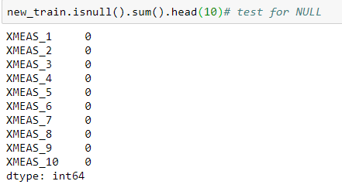
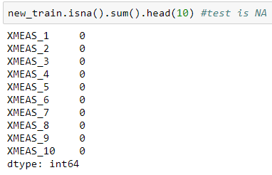
Data Exploration
Testing for NULL → data has no NULL values
Testing for NA → data has no NA values

Slide 14
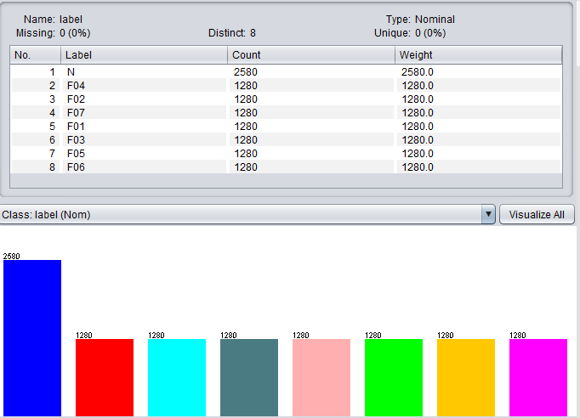
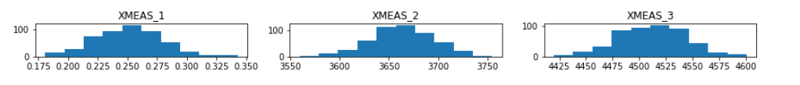
Data Exploration
class balance→ the fault data is balanced.
Data distribution (sample) → the data distribution follow a normal distribution. no outliers

Slide 15
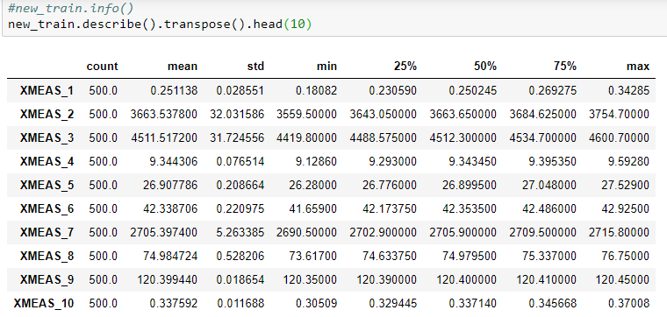
Data Exploration
Descriptive Statistics

Slide 16
Data Exploration
Example of a fault

Slide 17
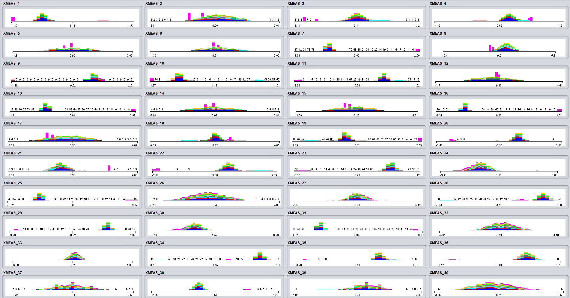
Data Manipulation
Standardization of the constructed Normal + Fault data set

Slide 18
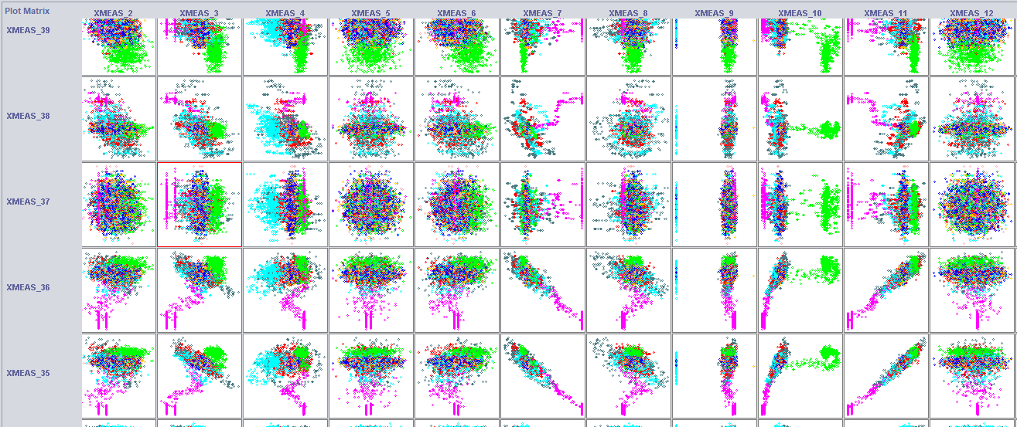
Data Manipulation
Attributes interaction – 2D

Slide 19
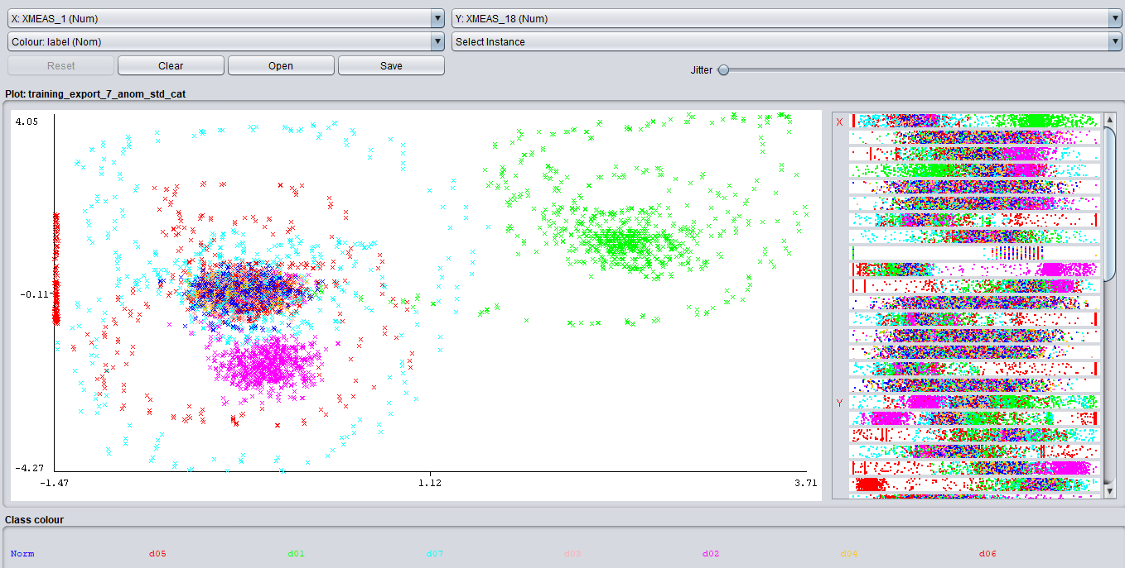
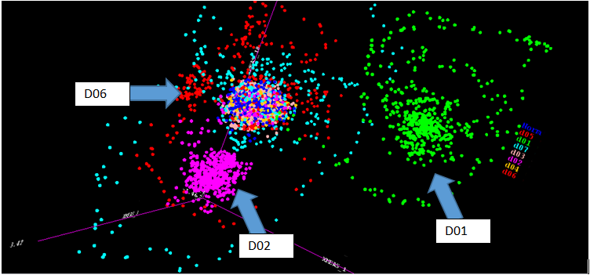
XMEAS_1
VS.
XMEAS_18

Slide 20
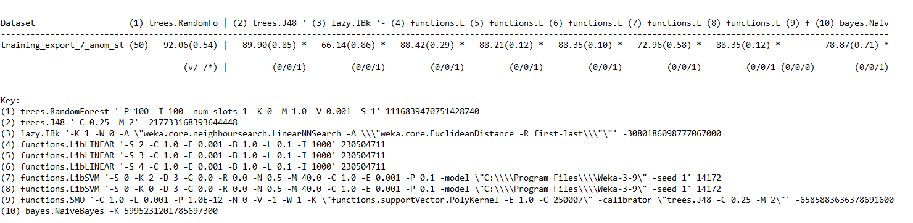
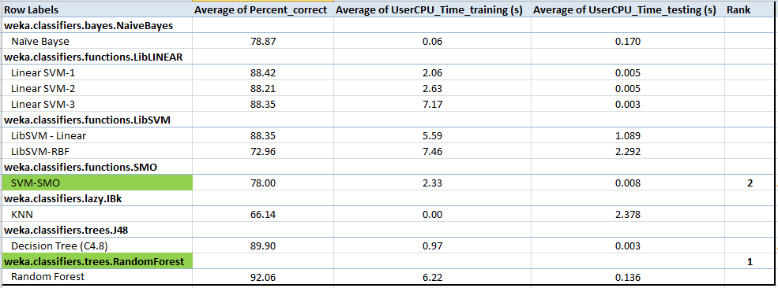
Algorithms Evaluation

Slide 21


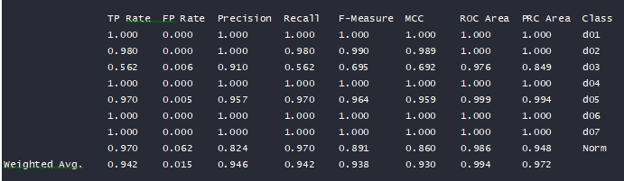
Model Selection/testing without feature selection
Random Forest multi-class → Break-ties randomly parameter enabled
Training
Testing

Slide 22
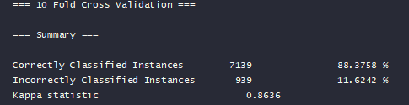

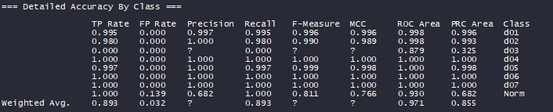
Model Selection/testing without feature selection
SVM→ Using Linear Kernel and the decision tree for calibration of SVM output
Training
Testing

Slide 23
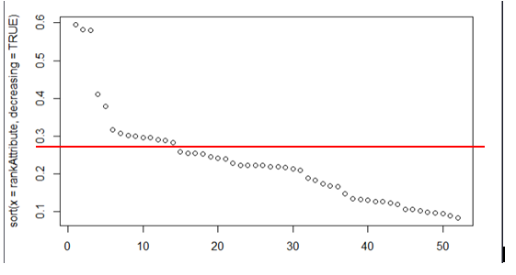
Model Selection/testing with feature selection
Using Rweka function “weka.attributeSelection.ClassifierAttributeEval “ the 15 most contributing features were selected

Slide 24

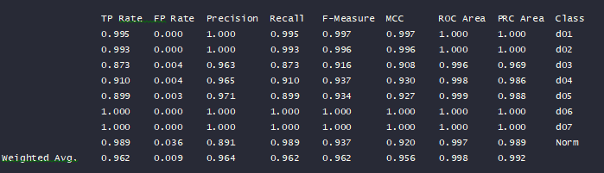
Random Forest
Testing

Slide 25

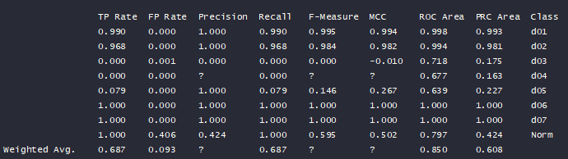
SVM
Testing

Slide 26




Model Selection/testing Cross-Project Validation
randomForest only used as it is the best performing
Without feature selection
With Feature selection

Slide 27
Summary results table

Slide 28
Conclusion and Nest step
Random-Forest generated the best performance at any level of comparison.
Using Attribute selection the computing cost of Random Forest has improved by about 20% with almost no sacrifice on the performance metrics
In binary classification RF performed better compared to multi-class.
We were able to improve Cross-project prediction by applying feature selection.
Next step:
study more the Cross-project Defect detection. Random Forest showed the potential to be applied in this domain. Cross-project defect detection presents a potential growth opportunity as there is the need to apply existing ML algorithm to accelerate the detection of new issues that have potentially no data for training.

Slide 29
Annex
Github link:
https://github.com/helmorra/Ryerson-capstone-project-2019

